Slide 1
Frankenstein
Volume II

Slide 2
Today’s Discussion
The creature’s education
Allusions and references
The “man versus monster” debate explored
Questions for the day
Quiz

Slide 3
Frankenstein’s “Monster” ’s Story
Volume II focuses on giving the creation a voice in the novel
With regard to the frame-narrative, we are in the center of the three narrators’ nests (Walton’s letters, Frankenstein’s story, and now the monster’s)
Question to consider: are we still, as readers, influenced by Walton or Frankenstein when we read the monster’s story?

Slide 4
The Creature’s Education
Frankenstein’s “creature” learns French through immersing himself in the language and by later reading three books found “on the ground” in a “leathern portmanteau” (Shelley 88).
Key Texts include: John Milton’s Paradise Lost, Plutarch’s Lives, and Goethe’s The Sorrows of Young Werther

Slide 5
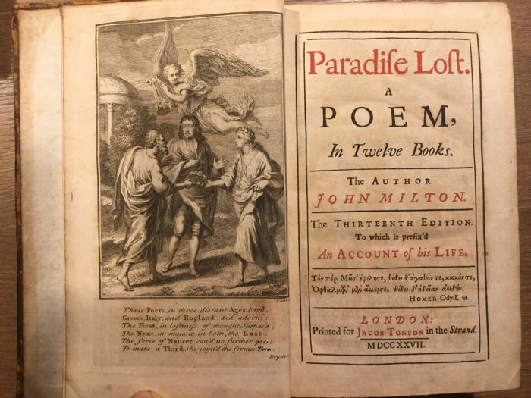
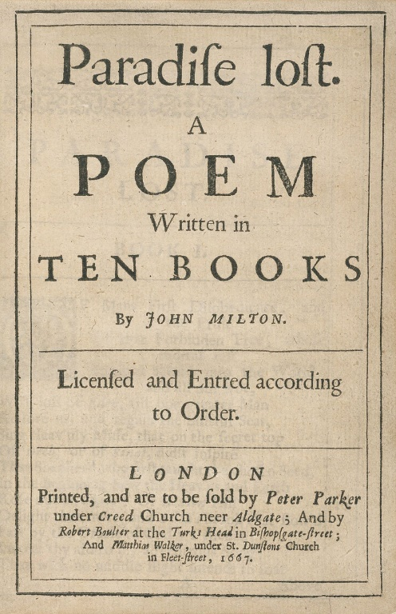
Milton’s Paradise Lost (1667, revised 1674)

Slide 6
Paradise Lost
Milton’s canonical epic poem tells the story of Satan’s war with God and fall from heaven to hell, the creation of mankind, the temptation of Adam and Eve by Satan, and their own fall into original sin
Speculation on when Milton wrote the poem; could have been written before, during, and/or after the English Civil War (1642-1651)
English Civil War resulted in the execution of King Charles I in 1649, the exile of his son, and the move from a monarchy to a commonwealth (Charles II would be restored to the throne in 1660, before the publication of PL)

Slide 7
Satan
The epic poem begins “in medias res” (Latin for “in the middle of things.)
Satan, also known as Lucifer, is sulking in Hell with other rebel angels
They have been banished to Hell after rebelling then battling God and his angels
Satan is a skilled speaker: he uses sophisticated rhetoric to persuade his rebel angels to “make a heaven of hell”

Slide 8
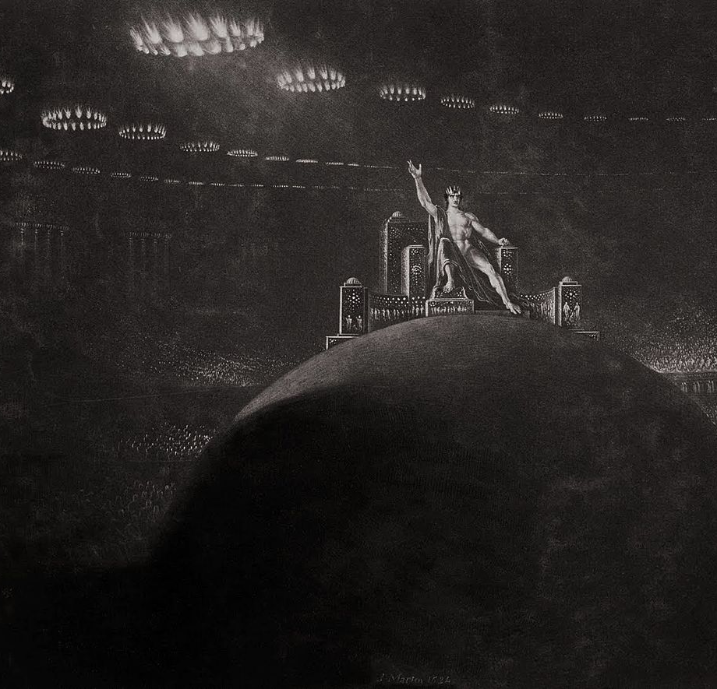
Satan’s rule in Hell

Slide 9
Adam and Eve
Meanwhile, while Satan sits in Hell and plots against God—HE has created Earth and mankind
He creates man, Adam, followed by woman, Eve
They are “free from sin” and live without guilt or shame in the Garden of Eden
Satan realizes he will take his revenge on God by introducing sin to Adam and Eve

Slide 10
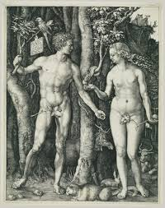
Adam and Eve (with Satan the snake)

Slide 11
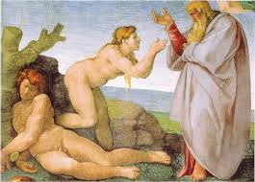

Slide 12
Adam and Eve
Satan sneaks into the Garden of Eden and disguises himself as a snake
He tempts Eve to eat an apple from the tree of knowledge (forbidden by God)
She eats it and then tempts Adam to do the same
They eat the apple and are filled with guilt and shame for being naked
God expels them from the Garden and punishes them with hard-work in the fields (Adam) and childbirth (Eve)

Slide 13

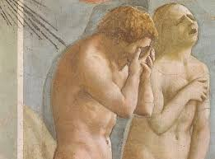

Slide 14
The Creature’s Close-Reading of Milton’s Paradise Lost
The creature relates to both Adam and to Satan when he describes his miserable existence to Frankenstein
The novel begins with Adam’s quote: “Did I request thee, Maker, from my clay/To mould me man? Did I solicit thee/From darkness to promote me?” (Book X 743-45)
God creates Adam as Frankenstein created the creature: this reading suggests a more positive reading of both characters since God loves Adam (despite Adam’s disobedience and God’s punishments)

Slide 15
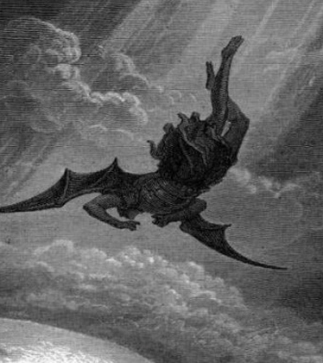
Satan/the Monster
The creature also relates to Lucifer, the fallen angel who becomes Satan, ruler of Hell
After he frightens the family DeLacey, the creature says: “I, like the arch fiend, bore a hell within me” (Satan says: “Which way I fly is Hell; myself am Hell”)

Slide 16
The Creature’s Intelligence
Self-aware
Critical
Quick-learner
Cultured
Elegant speaker
Persuasive

Slide 17
Should Frankenstein build a woman for his creature?
Consider the link between Eve and the woman the monster wants
What are the potential negative and positive consequences of building a woman for the creature?
What would you do if you were Frankenstein?

Slide 18
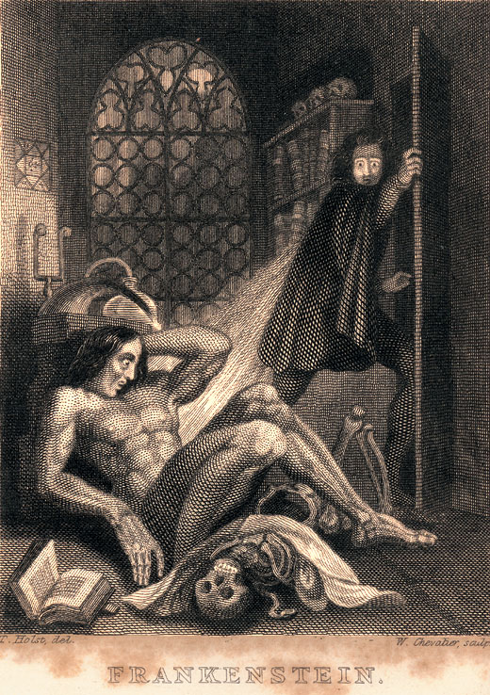
How monstrous is Frankenstein’s monster?

Slide 19
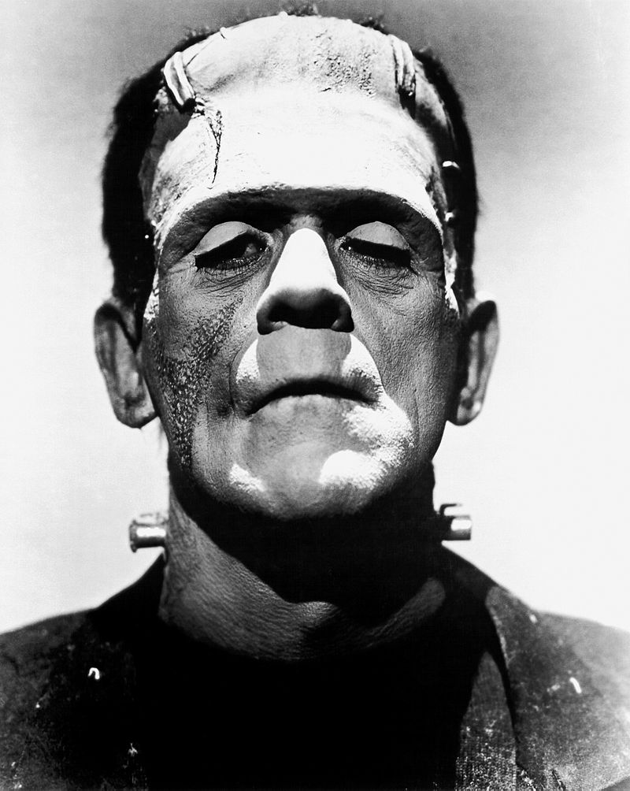

Slide 20
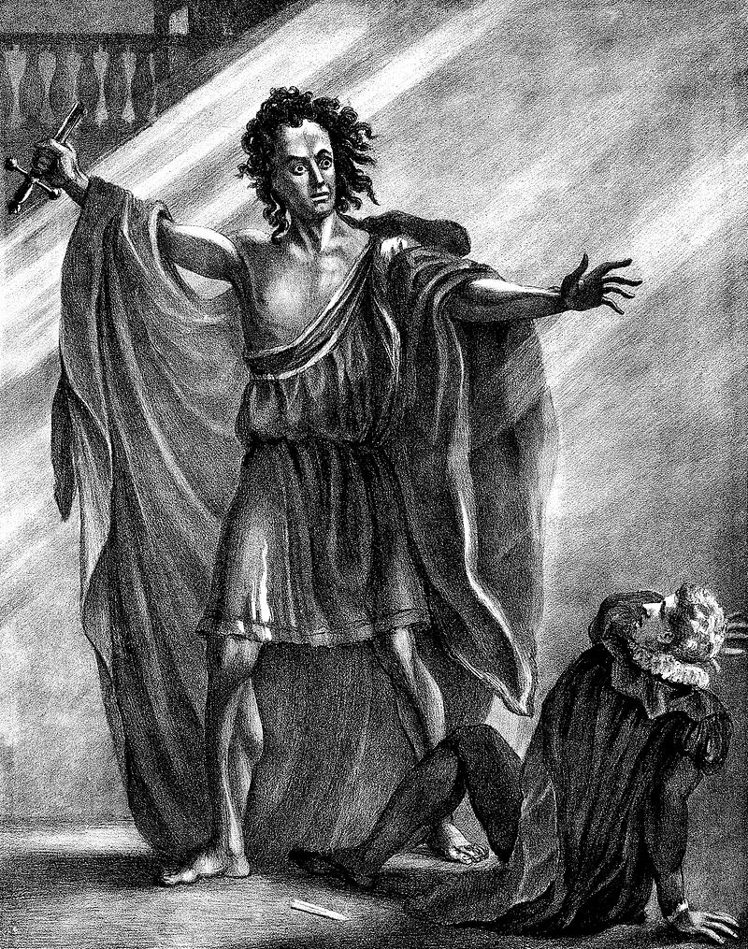

Slide 21
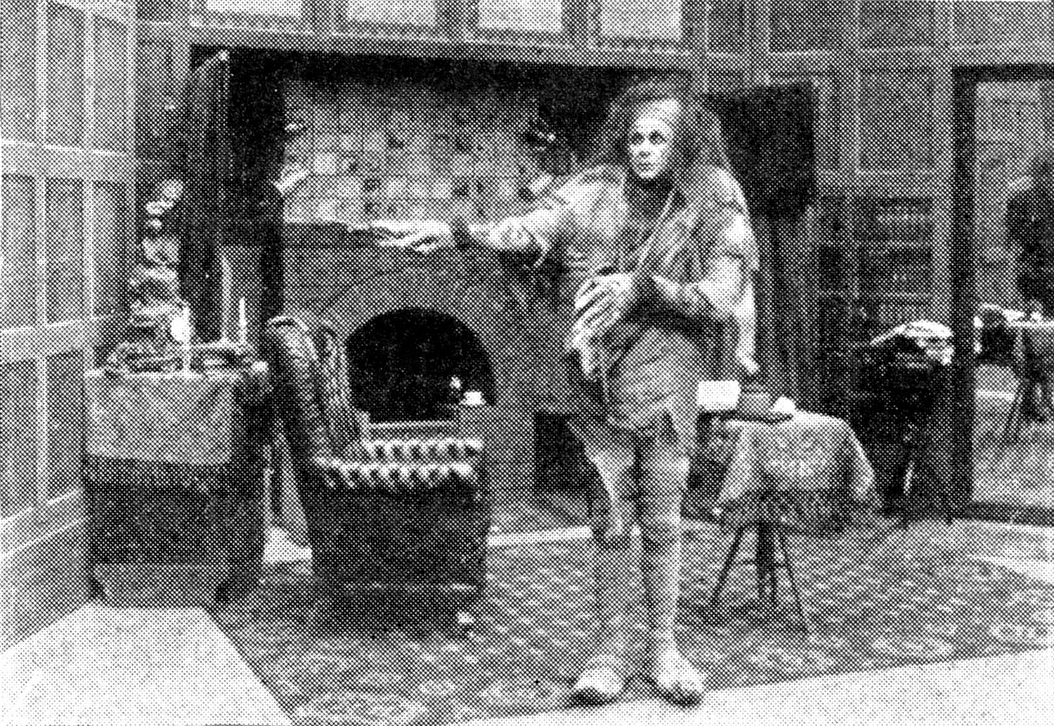

Slide 22
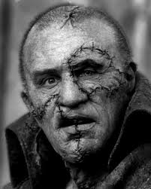
And now….the quiz!

Slide 23
Quiz Four
1. Why was Felix depressed when the creature first “met” him? (brief background on his past)
2. How does the creature help the DeLacey family?
3. How does the creature learn to speak and read?
Extra Credit: The creature thinks he is like Satan because he feels “the bitter gall of [-------]”rise within him when he views the “bliss” of the DeLaceys’. Fill in the blank
Extra Credit: What is difference in the meaning between using the term “creature” rather than “monster.” What other word would/could you use?

